Slide 1
Enhance Python Apps With Modern Icons Using Iconipy

Slide 2
What is iconipy?
Iconipy is a versatile Python package designed for creating and managing icons directly from your code.
It supports multiple icon sets and allows seamless integration with various GUI frameworks like Qt (PyQt6 / PySide6), Tkinter, PySimpleGUI, Kivy, DearPyGUI and more.
With Iconipy, you can customize icon properties such as size, color, and background, making it an essential tool for developers looking to enhance their application’s visual appeal.
Its ease of use and flexibility make it a popular choice for both beginners and experienced developers

Slide 3
Key Features And Benefits
Versatile Icon Creation: Supports multiple popular icon sets (Lucide Icons, Google Material Icons, Lineicons, Boxicons) and allows for extensive customization of icon properties such as size, color, and background. (Developers can add their own icon sets as well)
Multi-Framework Compatibility: Seamlessly integrates with various GUI frameworks including Qt, Tkinter, FreeSimpleGUI, NiceGUI, DearPyGUI, and so on - making it adaptable for different projects.
Ease of Use: Simple and intuitive API design that makes it easy for both beginners and experienced developers to create and manage icons.
Enhanced Visual Appeal: Helps in enhancing the visual appeal of applications by providing high-quality, customizable icons.
Efficient Development: Saves time and effort in icon creation, allowing developers to focus more on core functionality and less on design details.
Open Source: Being open-source, it encourages community contributions and continuous improvement.

Slide 4
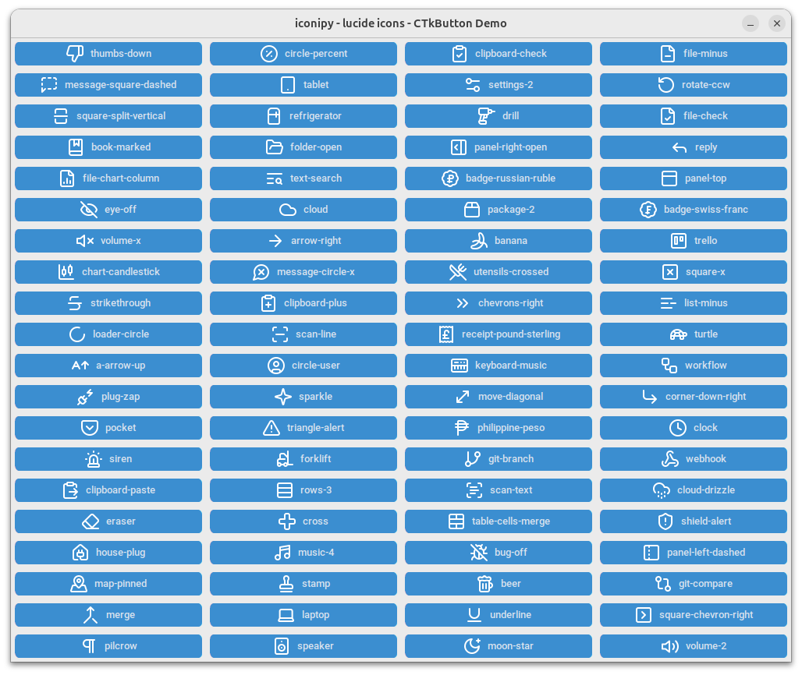
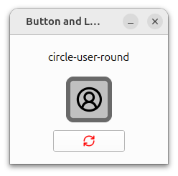
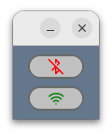
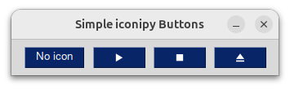
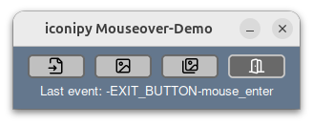
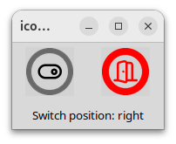
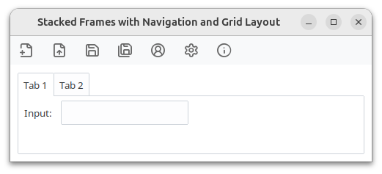
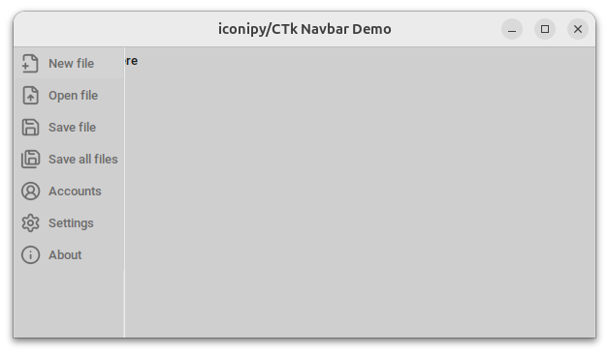
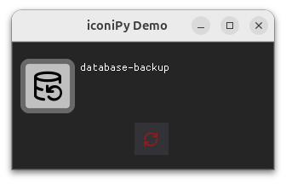
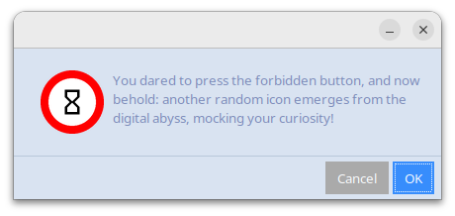
What does it look like?
Check out these screenshots showcasing demo applications featuring iconipy icons and image buttons.

Slide 5
Install iconipy
To install the iconipy package in Python, you can use the following command in your terminal or command prompt:
pip install iconipy
Once installed, you can start using it to create icons directly from your code. Here’s a basic example to get you started:
from iconipy import IconFactory
# Initialize an IconFactory with desired settings
create_icon = IconFactory(icon_size = 20)
# Create an icon
icon_home = create_icon.asPil('house') # PIL Image

Slide 6
The IconFactory concept
The IconFactory concept is a powerful way to manage and customize the appearance of icons in your application. Here’s how it works:
Centralized Design: By creating an IconFactory for each style, you centralize the design settings in one place of your Python code. This means you can easily update the look and feel of all icons by modifying the IconFactory settings, rather than changing each icon individually.
Code Reusability: Instead of duplicating code for each icon, you define the style once in the IconFactory. This promotes code reusability and reduces redundancy, making your codebase cleaner and more maintainable.
Consistency: Using an IconFactory ensures that all icons created with it share the same style attributes, such as size, color, and outline. This consistency is crucial for a cohesive user interface.
Flexibility: You can create multiple IconFactory instances for different states or themes. For example, one IconFactory for the normal button state and another for the mouse-over state. This allows you to switch styles dynamically based on user interactions or application states.

Slide 7
Customize your icon’s look-and-feel
You can easily customize the appearance of your icons by creating an IconFactory for each style you need. For example, you can have one IconFactory for the normal button state and another for the mouse-over state. This approach allows you to quickly update the design for all icons / buttons by modifying a single location in your Python code.
from iconipy import IconFactory
create_button_icon = IconFactory(
icon_set = 'lucide',
icon_size = (128,64),
font_size = 38,
font_color = (0, 0, 0, 255), # black solid
outline_color = 'dimgrey',
outline_width = 6,
background_color = '#5500FF',
background_radius = 10
)

Slide 8
Icon Sets
You can choose from the icon sets that ship with iconipy:
lucide
boxicons
lineicons
material_icons_regular
material_icons_round_regular
material_icons_sharp_regular
material_icons_outlined_regular
Check out the docs to learn how to add
your own icon sets.
from iconipy import IconFactory
create_icon = IconFactory(icon_set='lucide')

Slide 9
Icon Names
To create an icon you need to know it’s name.
You can search for matching icon names like this:
print(create_icon.search('hand'))
Or you can print all available icon names for the IconFactory’s icon set:
print(create_icon.icon_names)
Preview an icon with:
create_icon.show('house')
from iconipy import IconFactory
create_icon = IconFactory(icon_set='lucide')
print(create_button_icon.search('hand'))
print(create_button_icon.icon_names)

Slide 10
Icon Formats
Not all GUI frameworks support the same image formats. Therefore, you need to use the appropriate function to create your icons. For instance, some frameworks can use PIL images directly, while others have their own formats (such as QPixmap or PhotoImage) or simply accept paths to actual files.
icon_home = create_button_icon.asPil('house') # CustomTkinter, wxPython, NiceGUI
icon_save = create_button_icon.asBytes('save') # PySimpleGUI, FreeSimpleGUI
icon_files = create_button_icon.asTkPhotoImage('files') # tkinter based
icon_folder = create_button_icon.asTkBitmapImage('folder') # tkinter based
icon_reload = create_button_icon.asQPixmap('refresh-cw') # PyQt, PySide
icon_exit_app = create_button_icon.asRawList('log-out') # DearPyGUI
icon_sticker = create_button_icon.asTempFile('sticker') # Kivy and all the rest...

Slide 11
Docs
For comprehensive sample code and detailed documentation on the most popular GUI toolkits, visit
GitHub: https://github.com/digidigital/iconipy
or
Iconipy’s official site: https://iconipy.digidigital.de
These resources provide valuable insights and examples to help you create stunning icons directly from your Python code, tailored to various GUI frameworks.
Explore these links to streamline your icon creation process and enhance your user interfaces with ease.

Slide 12
„Hello World“
Code Examples
In the following slides, we’ll explore some basic examples of using iconipy with various frameworks.
Please note that these examples only scratch the surface of the customization options available for your icons.
For more comprehensive and realistic scenarios, follow the links provided at the bottom of each slide to access detailed examples and advanced documentation.

Slide 13
Buttons with icons in tkinter
import tkinter as tk
from iconipy import IconFactory
# Initialize IconFactory (default settings except for a custom icon size of 20)
create_icon = IconFactory(icon_size=20)
# Create the main application window
window = tk.Tk()
# Generate an icon of a globe
world_icon = create_icon.asTkPhotoImage('globe')
# Create a button with text and an icon, then add it to the window
button = tk.Button(window, text='Hello World!', image=world_icon, compound=tk.LEFT)
button.grid(row=0, column=0, padx=10, pady=10)
# Run the application's event loop
window.mainloop()
Check out more complex examples here: https://github.com/digidigital/iconipy/tree/main/demo_programs/tkinter

Slide 14
PySimpleGUI and
FreeSimpleGUI Icon Button
try:
import FreeSimpleGUI as sg
except:
import PySimpleGUI as sg
from iconipy import IconFactory
create_icon = IconFactory(icon_size=20) # Initialize IconFactory
icon_bytes = create_icon.asBytes('globe') # Create the icon as Bytes
layout = [
[sg.Text('Hello World Button Demo')],
[sg.Button('', image_data=icon_bytes, button_color=(sg.theme_background_color(), sg.theme_background_color()), border_width=0, key='Exit')]
]
window = sg.Window('Hello world button!', layout)
while True:
event, values = window.read()
if event in (sg.WIN_CLOSED, 'Exit'):
Break
Check out the other examples here: https://github.com/digidigital/iconipy/tree/main/demo_programs/FreeSimpleGUI_PySimpleGUI

Slide 15
Buttons with image in ttk
import tkinter as tk
from tkinter import ttk
from iconipy import IconFactory
# Initialize IconFactory (default settings except for a custom icon size of 20)
create_icon = IconFactory(icon_size=20)
# Create the main application window
window = tk.Tk()
# Generate an icon of a globe
world_icon = create_icon.asTkPhotoImage('globe')
# Create a button with text and an icon, then add it to the window
button = ttk.Button(window, text='Hello World!', image=world_icon, compound=tk.LEFT)
button.grid(row=0, column=0, padx=10, pady=10)
# Run the application's event loop
window.mainloop()
Check out more complex examples here: https://github.com/digidigital/iconipy/tree/main/demo_programs/ttk

Slide 16
Add image to button in ttkbootstrap
import tkinter as tk
import ttkbootstrap as ttk
from iconipy import IconFactory
# Initialize IconFactory (default settings except for a custom icon size of 20)
create_icon = IconFactory(icon_size=20)
# Create the main application window
window = tk.Tk()
# Apply the ttkbootstrap style
style = ttk.Style(theme="cosmo")
# Generate an icon of a globe
world_icon = create_icon.asTkPhotoImage('globe')
# Create a button with text and an icon, then add it to the window
button = ttk.Button(window, text='Hello World!', image=world_icon, compound=tk.LEFT)
button.grid(row=0, column=0, padx=10, pady=10)
# Run the application's event loop
window.mainloop()
Check out more complex examples here: https://github.com/digidigital/iconipy/tree/main/demo_programs/ttkbootstrap

Slide 17
CTkButton with icon / image
import customtkinter as ctk
from iconipy import IconFactory
# Initialize IconFactory (default settings except for a custom icon size of 20 and font color 'white')
create_icon = IconFactory(icon_size=20, font_color='white')
# Create the main application window
window = ctk.CTk()
# Generate an icon of a globe
world_icon = create_icon.asTkPhotoImage('globe')
# Create a button with text and an icon, then add it to the window
button = ctk.CTkButton(window, text='Hello World!', image=world_icon, compound='left')
button.grid(row=0, column=0, padx=10, pady=10)
# Run the application's event loop
window.mainloop()
Check out more complex examples here: https://github.com/digidigital/iconipy/tree/main/demo_programs/customtkinter

Slide 18
PyQt buttons with image
from PyQt6.QtWidgets import QApplication, QMainWindow, QPushButton, QVBoxLayout, Qwidget
from PyQt6.QtGui import Qicon
from PyQt6.QtCore import Qt
from iconipy import IconFactory
import sys
create_icon = IconFactory(icon_size=18, font_color='dimgrey') # Initialize IconFactory
app = QApplication(sys.argv) # Initialize the application
window = QMainWindow() # Create the main window
central_widget = QWidget() # Create a central widget and set a layout
layout = QVBoxLayout(central_widget)
globe_icon=create_icon.asQPixmap('globe') # Create icon as Qpixmap
button = QPushButton("Hello World!") # Create a button with text and an icon
button.setIcon(QIcon(globe_icon))layout.addWidget(button) # Add the button to the layout
window.setCentralWidget(central_widget) # Set the central widget
window.show() # Show the main window
sys.exit(app.exec()) # Run the application's event loop
Check out more complex examples here: https://github.com/digidigital/iconipy/tree/main/demo_programs/PyQt6

Slide 19
PySide – Add image to button
from PySide6.QtWidgets import QApplication, QMainWindow, QPushButton, QVBoxLayout, Qwidget
from PySide6.QtGui import Qicon
from PySide6.QtCore import Qt
from iconipy import IconFactory
import sys
create_icon = IconFactory(icon_size=18, font_color='dimgrey') # Initialize IconFactory
app = QApplication(sys.argv) # Initialize the application
window = QMainWindow() # Create the main window
central_widget = QWidget() # Create a central widget and set a layout
layout = QVBoxLayout(central_widget)
globe_icon=create_icon.asQPixmap('globe') # Create icon as Qpixmap
button = QPushButton("Hello World!") # Create a button with text and an icon
button.setIcon(QIcon(globe_icon))layout.addWidget(button) # Add the button to the layout
window.setCentralWidget(central_widget) # Set the central widget
window.show() # Show the main window
sys.exit(app.exec()) # Run the application's event loop
Check out the other examples here: https://github.com/digidigital/iconipy/tree/main/demo_programs/PySide6

Slide 20
wxPython
BitmapButton
import wx
from iconipy import IconFactory
app = wx.App()
frame = wx.Frame(None, -1, 'wxPython Hello World! Button')
frame.SetDimensions(0, 0, 200, 70)
panel = wx.Panel(frame, wx.ID_ANY)
# Initialize IconFactory for a simple icon with transparent background
create_icon = IconFactory(icon_set = 'lucide',
icon_size = 18,
font_color = 'grey') # (reg, green, blue. alpha)
# Create the icon as temp file and load it
# You can replace 'globe' with any valid icon name for the icon set
bmp = wx.Bitmap(create_icon.asTempFile('globe'), wx.BITMAP_TYPE_ANY)
# Create a BitmapButton with the loaded image
button = wx.BitmapButton(panel, id=wx.ID_ANY, bitmap=bmp, size=(64, 32))
frame.Show()
app.MainLoop()
More examples here: https://github.com/digidigital/iconipy/tree/main/demo_programs/wxPython

Slide 21
More
„Hello World“ Code Examples
That’s not all!
Iconipy supports even more frameworks than those covered in this presentation.
To explore how to integrate with additional toolkits, visit these websites:
Kivy →https://github.com/digidigital/iconipy/tree/main/demo_programs/kivy
NiceGUI →https://github.com/digidigital/iconipy/tree/main/demo_programs/NiceGUI
DearPyGui →https://github.com/digidigital/iconipy/tree/main/demo_programs/DearPyGUI
appJar →https://github.com/digidigital/iconipy/tree/main/demo_programs/appJar

